Slide 1
Project Title: RELOCATION OF CONTROLLER AND SWITCH GEAR UNIT FROM AFAM V POWER PLANT TO SPDC GAS RECEIVING FACILITY
Business Case/ Objectives:
The AFAM GRF is an Okoloma facility which allows for the Routing of Natural Gas Supply (Average 90mmscfd) from the Okoloma Gas Plant to the Afam VI Power Plant. Its Control system is currently located in the Afam V control room (due to proximity). However, power supply to the Afam V control room has been epileptic with time and the control room is no longer manned due to outage of the Afam V gas turbines. There have been several plant outages recently due to unreliable power supply to the control system from Afam V power supply source. Access to the control room is not controlled by SPDC leading to delays in response to Process or Control system challenges at Afam GRF.
This project is to move the control system closer into the Afam GRF where SPDC operations and maintenance personnel will have unrestricted access and the control system will have more reliable power supply to minimize the associated deferment.
Potential Benefits & Measurement:
Asset availability for continuous production to AFAM VI power plant
Ease of accessibility during Emergency Response and normal operations (Reduced intervention time)
Reliable source of power to the Control System cabinet
Easy ownership and care by SPDC Operations and Maintenance personnel
Project Scope/Actions :
Secure MoC for the change
Review designs, technical challenge and approval to be secured
Excavation, cable tray provision & installation, cable splicing & terminations.
Procure and install the packaged switch room
Procure and install UPS and UPS batteries
Test and commission
Critical Success Factors:
Asset Leadership/Stakeholder Support
Project Sponsor: Florence Oyedele/ Ikechukwu Onyeka
Implementation Lead: Omonigho Eguono /Osuji-Bells S
Project Team: Paco and Electrical teams
High-level Timeline:
L0-L1June 2018
L2: Aug 2018
L3:Sept. 2018
L4:Oct. 2018
L5: Nov. 2018
Initiative End (30 Dec. 2018)

Slide 2
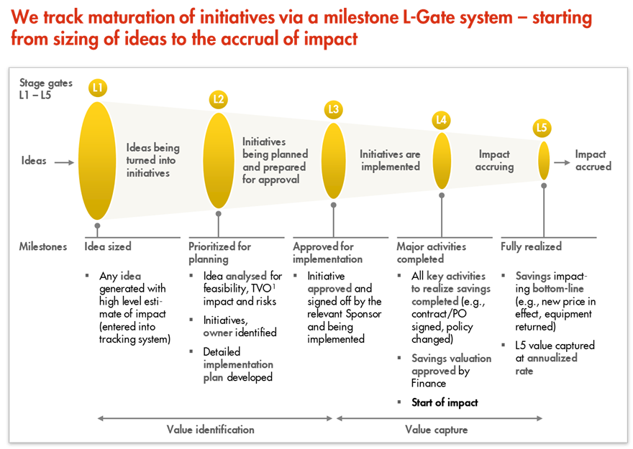
L1 – L5 Gates

